Slide 1

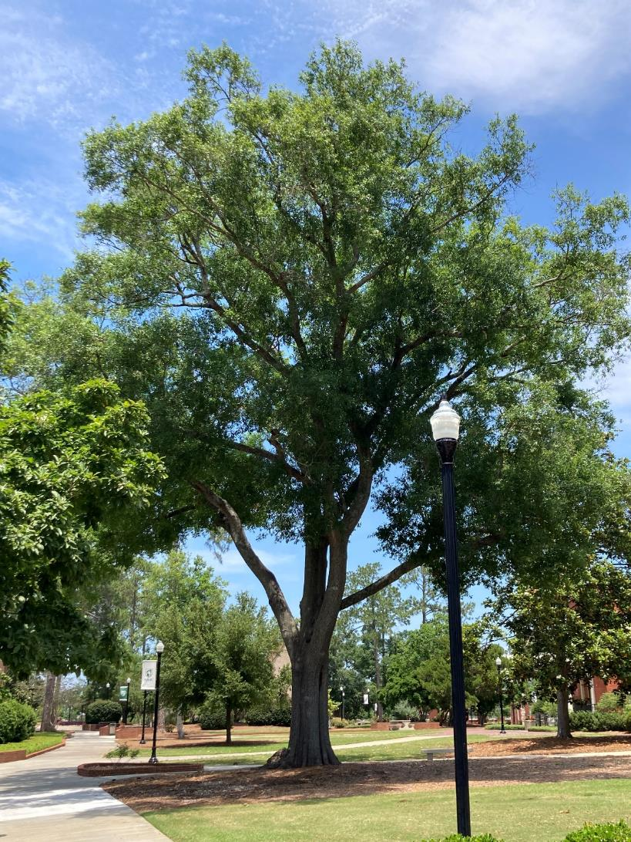

Tifton, Georgia
Tree Canopy Project Overview
Matthew Lee
Derek Matchette
Green Infrastructure Center
www.gicinc.org
January 24, 2024

Slide 2

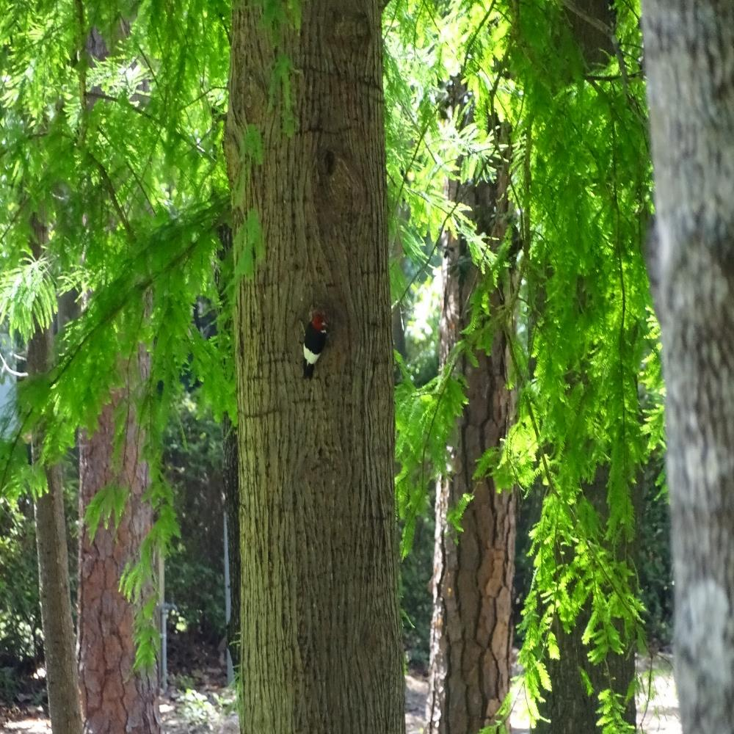

Canopy Mapping and Urban Forest Project
GREEN INFRASTRUCTURE CENTER INC.
Tree Canopy data
Tree Canopy Analysis
Ecosystem Services
Tree Codes
Canopy Goal & Strategies

Slide 3



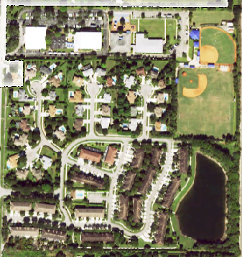
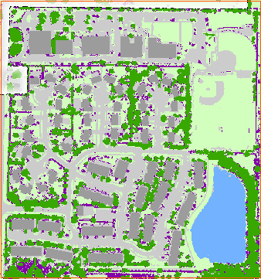
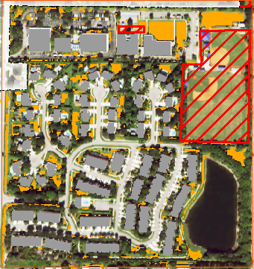
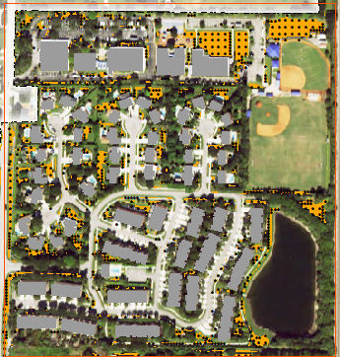
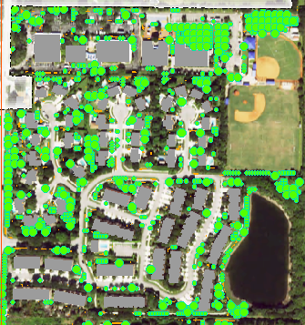
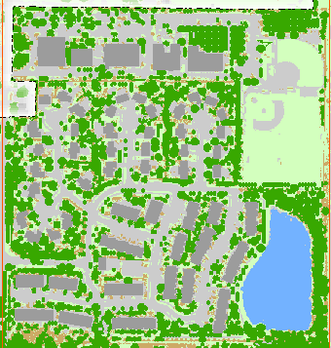
DETERMINING POTENTIAL CANOPY AREA (PCA)
GREEN INFRASTRUCTURE CENTER INC.
NAIP Leaf-On
Land Cover
Potential Planting Area (PPA)
Potential Planting Spots (PPS)
Potential Canopy Area (PCA)
Potential Land Cover

Slide 4


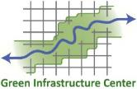
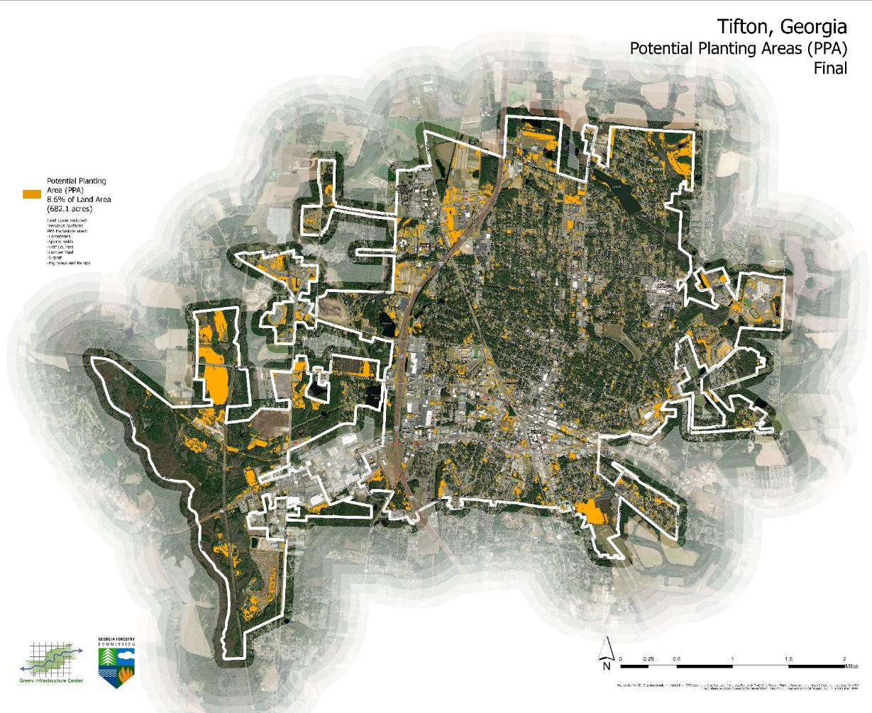
GREEN INFRASTRUCTURE CENTER INC.
Tifton
Potential Planting Areas (PPA)
Citywide 14.5% (Draft)
Citywide 8.6% (Final)
1,150 Acres (Draft)
682 Acres (Final)
If 100% of PPA was planted:
Total trees – 71,549
Small trees (20 ft diameter crowns) – 33,850
Large trees (40 ft diameter crowns) – 37,699

Slide 5
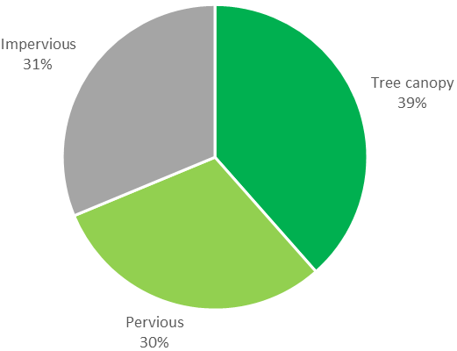
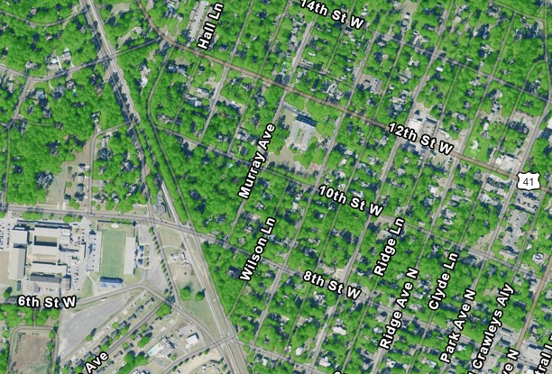
GREEN INFRASTRUCTURE CENTER INC.
Tifton Canopy
Citywide 39% (Final)
Citywide Potential TC 51% (Final)

Slide 6
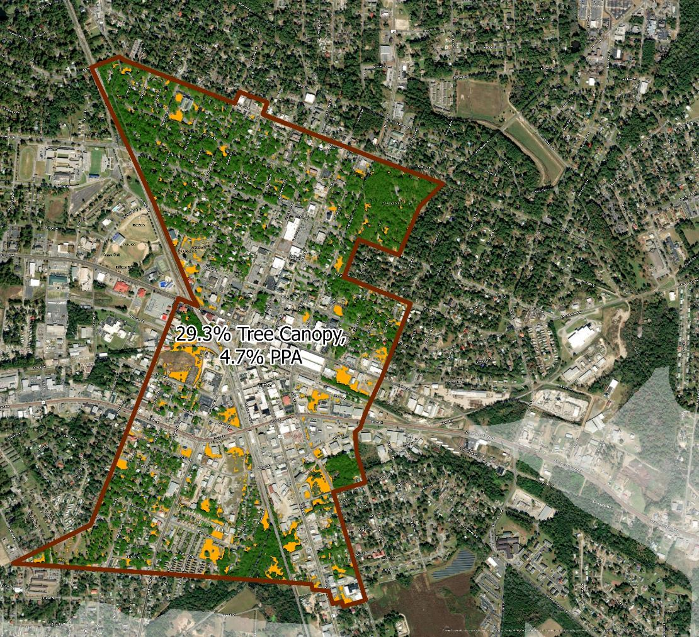
Downtown Development Authority
GREEN INFRASTRUCTURE CENTER INC.
The DDA has an average tree canopy of 29% and 4.7% PPA or 35 acres.
There is room to plant 4,314 more trees in the district for maximum tree canopy of 37%.
These are split between small trees 2,340 and large trees 1,974. Large trees give the most ecosystem services or environmental benefits.

Slide 7
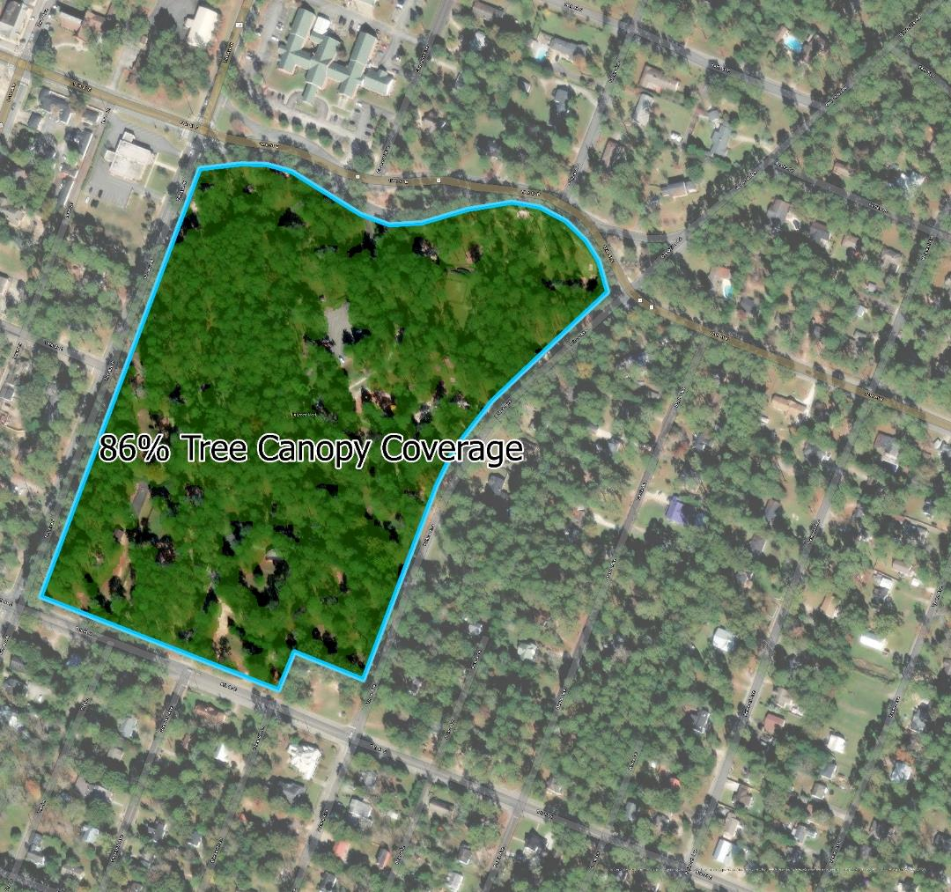
Fulwood Park
GREEN INFRASTRUCTURE CENTER INC.
The park has an average of 86% tree canopy. There is 0.57 acres of PPA.
There is room to plant 49 small trees and 29 large trees for a total of 78 more trees.
While the canopy is currently very high in the park, there are few younger trees found. To ensure the next generation of trees in Fulwood, residents and the city need to prioritize new plantings.

Slide 8
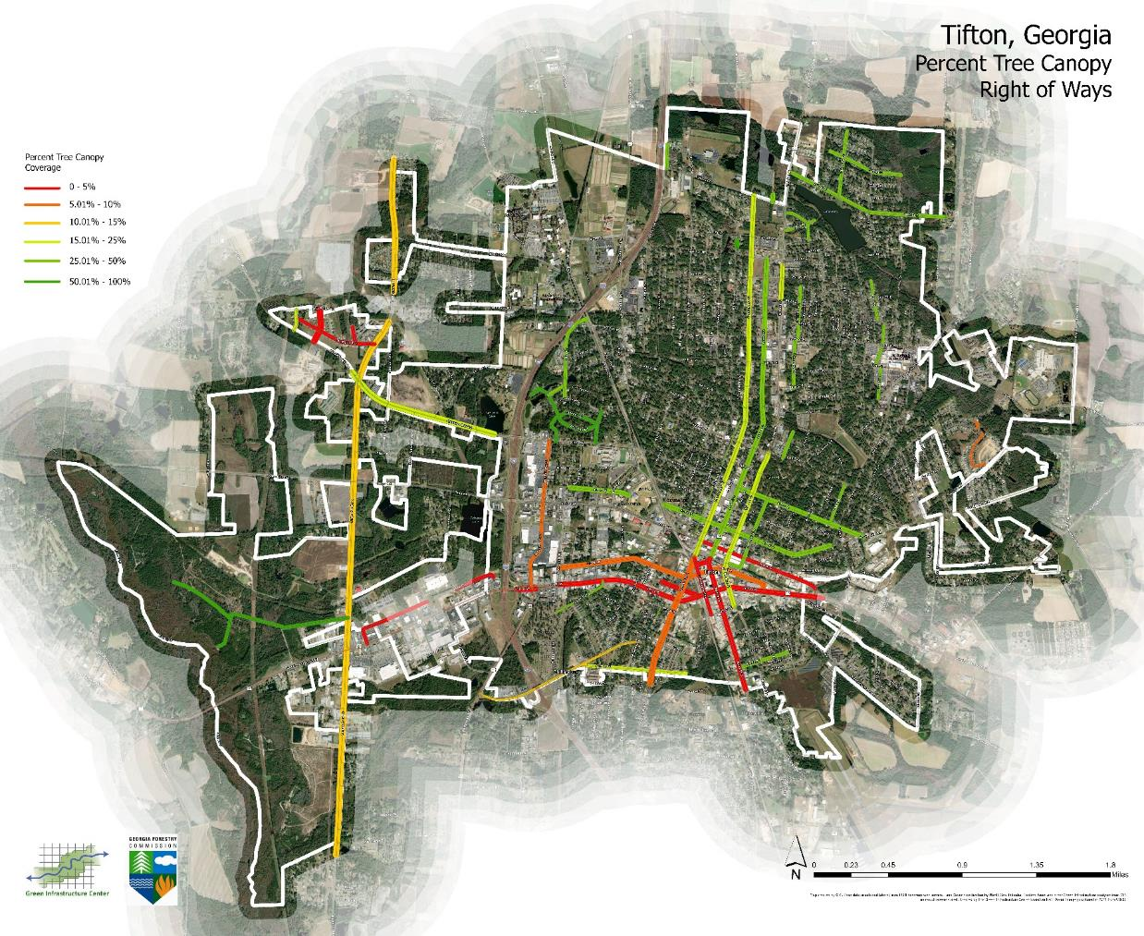
Rights of Way (ROW)
GREEN INFRASTRUCTURE CENTER INC.
Currently there are 11 streets with the potential to increase canopy in the ROW by 10% or more.
2 streets have less than 10% canopy: Mill Way and Oak Point Ave.
A total of 3,859 more trees could be planted within the identified rights-of-way.
Some areas are going to require better planting standards to limit conflict with nearby utilities or other hardscapes.
Some areas are going to require private property owners to agree to plant trees on their properties.

Slide 9
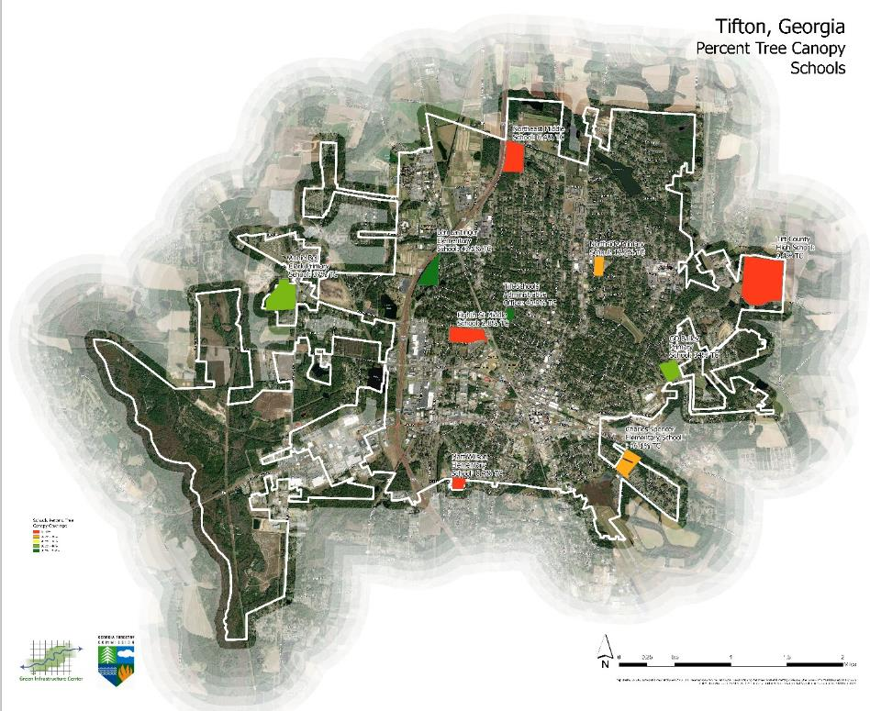
Schools
GREEN INFRASTRUCTURE CENTER INC.
There are 4 schools with less than 10% tree canopy and room to plant 1,497 more trees on these properties.
This already excludes places such as athletic fields where we don’t want to plant trees.
This is a great opportunity to engage youth in tree planting and the environment. This could be great volunteer projects for high school or UGA students.

Slide 10

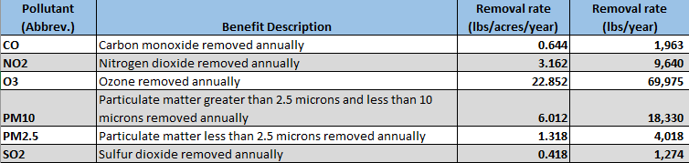
Air Quality Benefits (2021 data)
ECOSYSTEM SERVICES
GREEN INFRASTRUCTURE CENTER INC.
Source: Hirabayashi, 2014, “i-Tree Canopy Air Pollutant Removal and Monetary Value Model Descriptions”

Slide 11

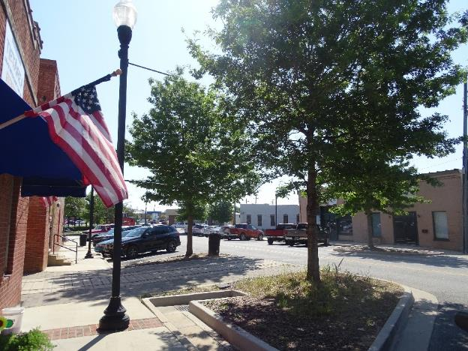
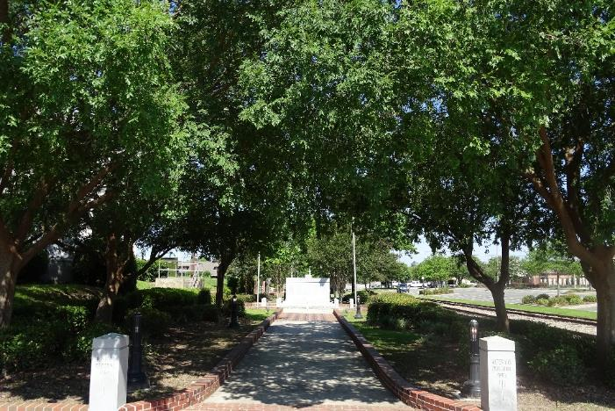
Carbon Sequestration & Storage (2021 data)
ECOSYSTEM SERVICES
GREEN INFRASTRUCTURE CENTER INC.
Source: Nowak, D. et al., 2013, “Carbon storage and sequestration by trees in urban and community areas of the United States”

Slide 12
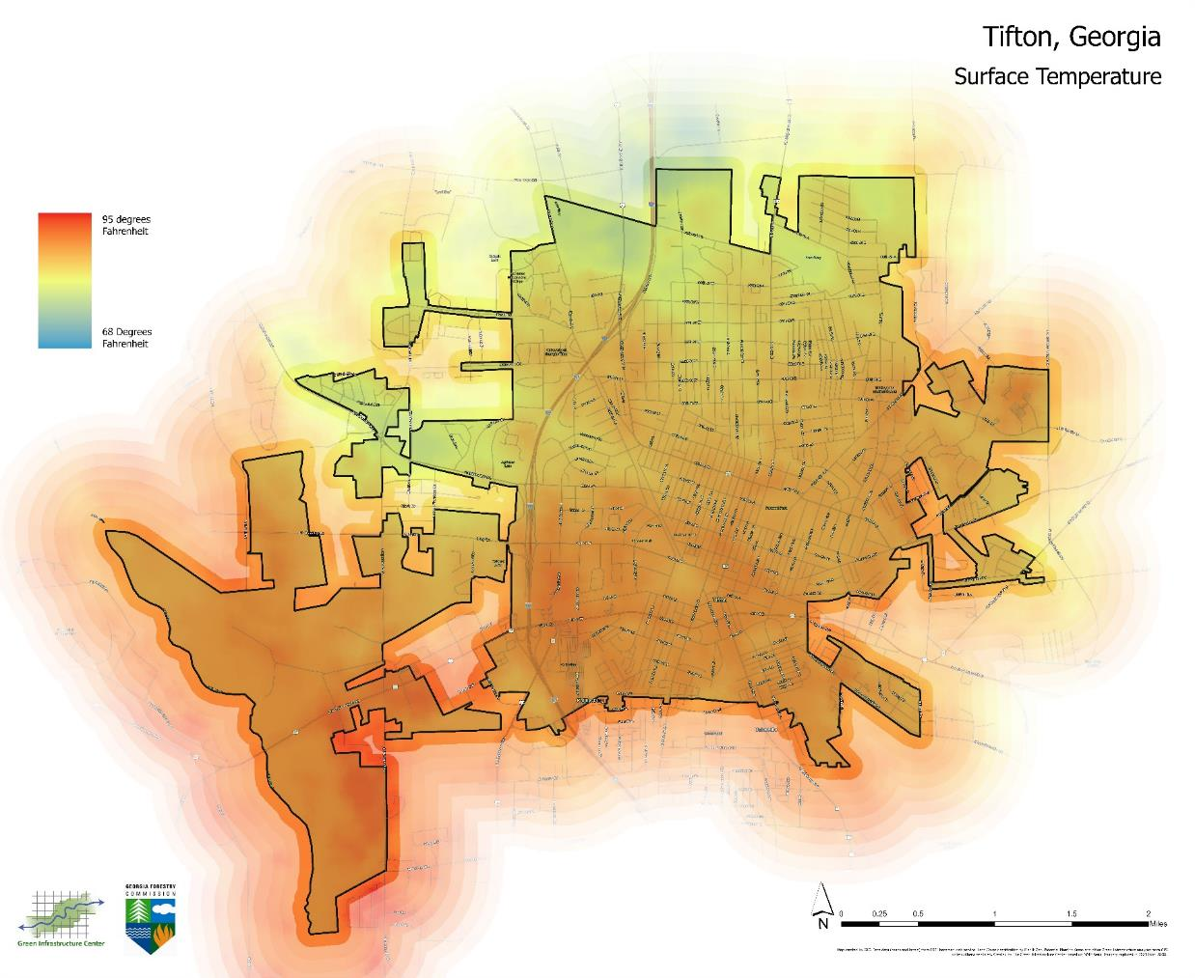
Surface Heat and Shade
ECOSYSTEM SERVICES
GREEN INFRASTRUCTURE CENTER INC.
Number of days above 100˚F**
**Data are drawn from the July 2019 report, Killer Heat in the United States: Climate Choices and the Future of Dangerously Hot Days
Where we are now | Where we are currently headed |  | If Bold Action is Taken
Historically 1971-2000 average | Midcentury 2036-2065 average | Late Century 2070-2099 average | Extreme Heat Limited to
18 days per year | 81 days per year | 115 days per year | 63 days per year

Slide 13
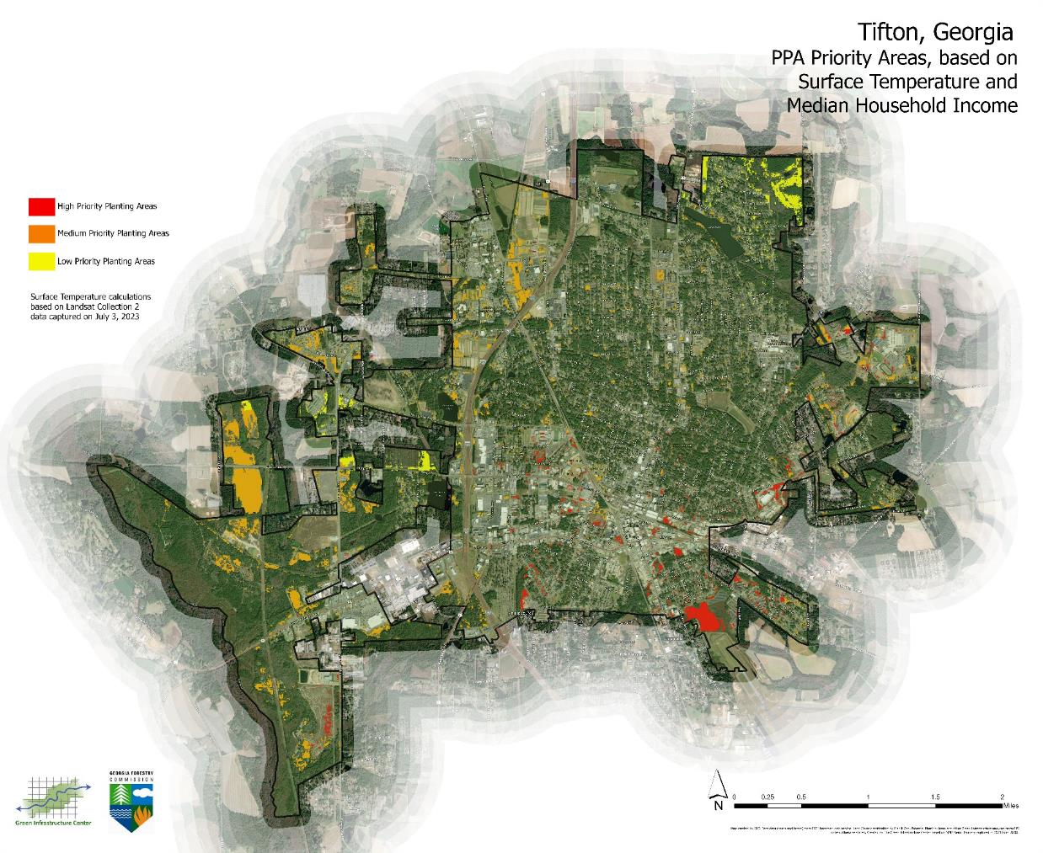
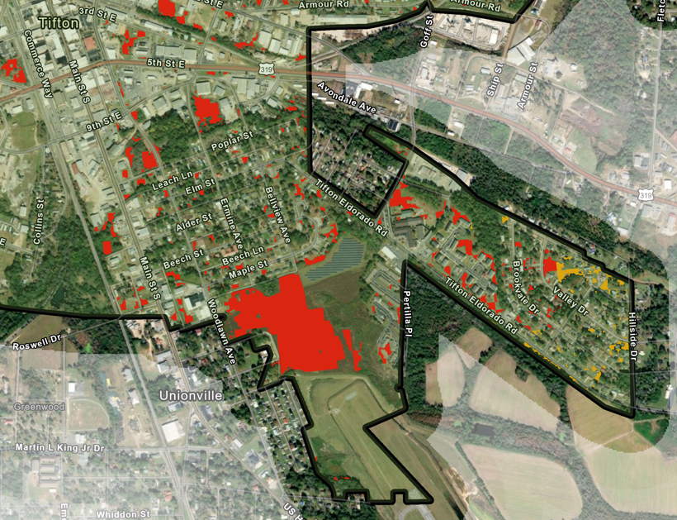
ECOSYSTEM SERVICES
GREEN INFRASTRUCTURE CENTER INC.
The surface temperature data was combined with Census data to identify the hottest planting areas of the city that also have low income populations.
High priority areas – 83 acres of PPA
Moderate priority areas – 303 acres of PPA
Low priority areas – 66 acres of PPA

Slide 14
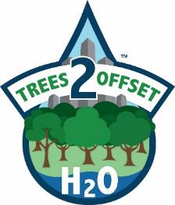
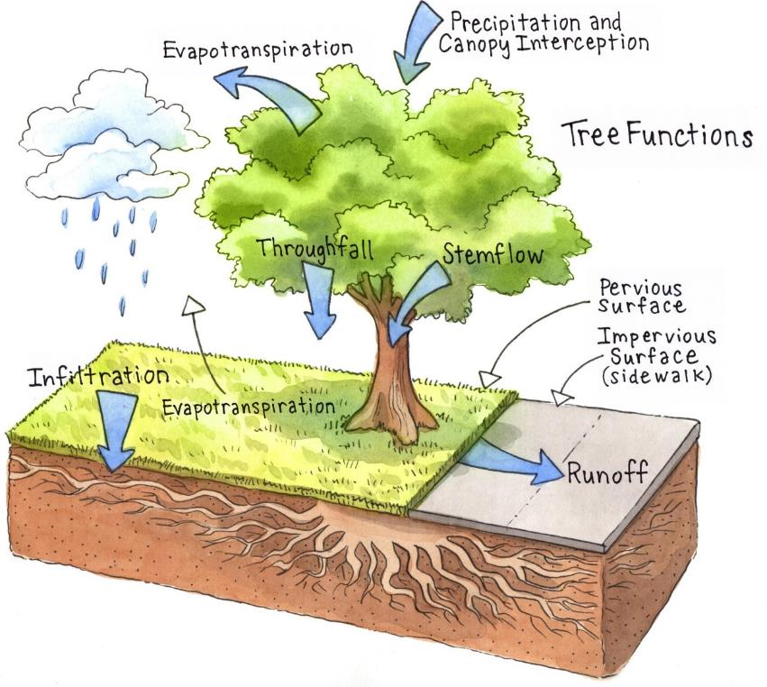
Urban Tree Canopy
ECOSYSTEM SERVICES
GREEN INFRASTRUCTURE CENTER INC.
20% of annual rainfall or > retained in crown (Xiao et al., 2000)
Delays runoff up to 3.7 hours
infiltration capacity of soils

Slide 15
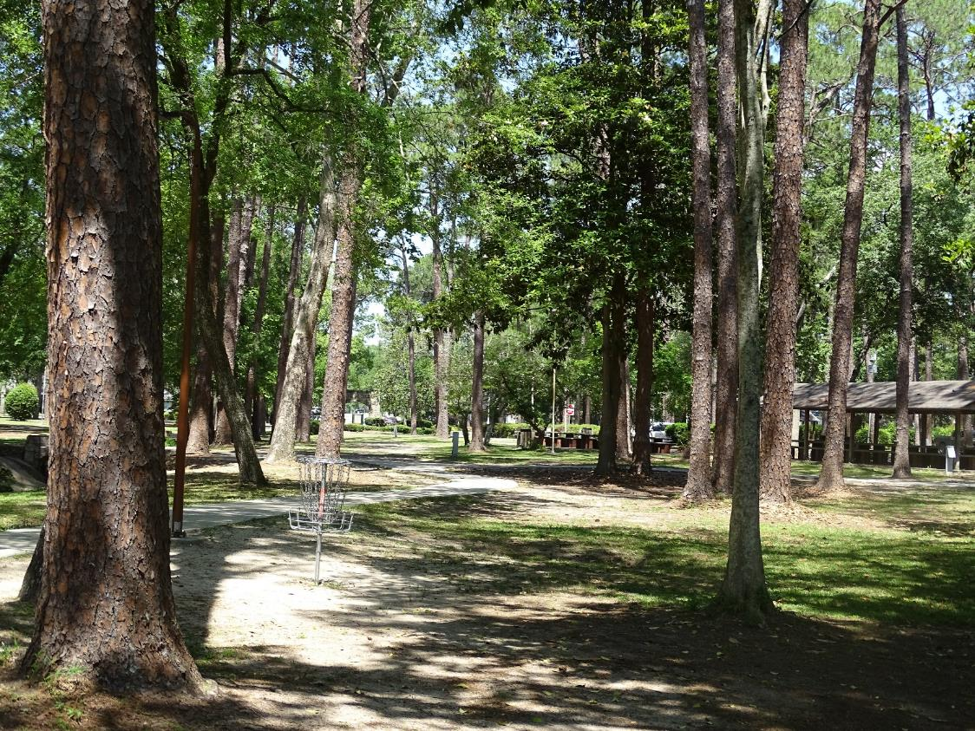
Water Quality and Quantity
ECOSYSTEM SERVICES
GREEN INFRASTRUCTURE CENTER INC.
The City’s current tree canopy captures:
18.3 million gallons of stormwater runoff for every 1yr/24-hour rainfall event which equals 3.38 inches.
24,366 lbs/year of Nitrogen
1,993 lbs/year of Phosphorus
1,204 tons/year of sediment

Slide 16
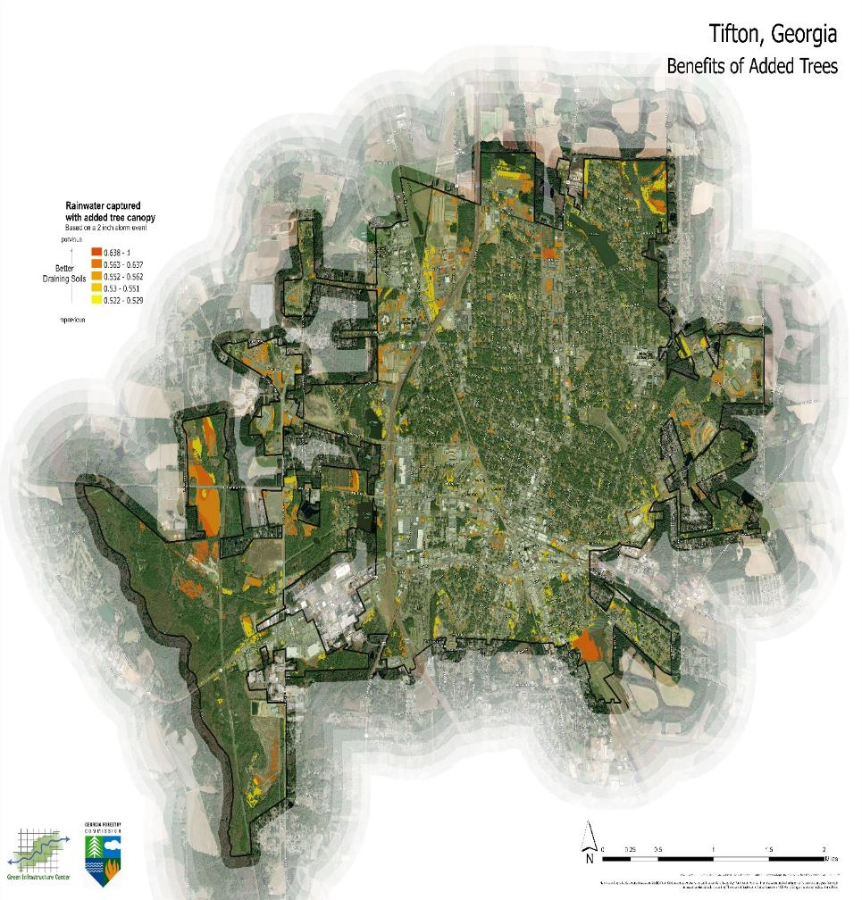
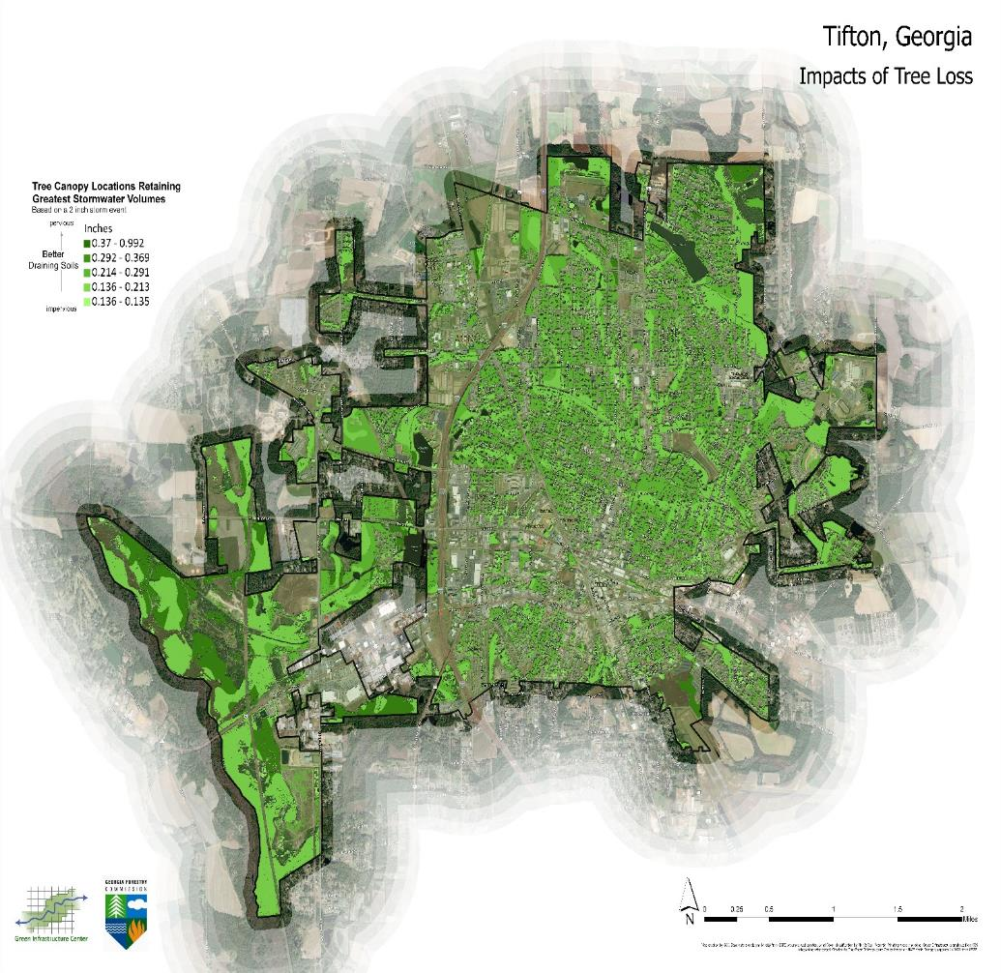
GREEN INFRASTRUCTURE CENTER INC.

Slide 17
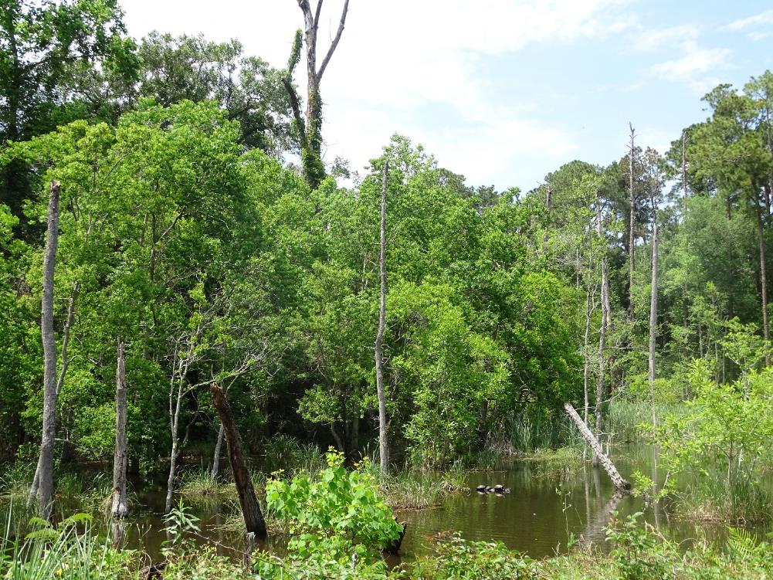
ECOSYSTEM SERVICES
GREEN INFRASTRUCTURE CENTER INC.
Tools to use for Tree Canopy Planning
Canopy Budget Calculator
Trees and Stormwater Calculator
Tree Codes and Ordinances Audit Tool
GIS data for strategic planning and planting.
A report and foundation for building tree canopy capacity.

Slide 18



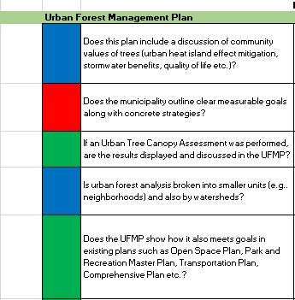
AUDIT TOOL
GREEN INFRASTRUCTURE CENTER INC.
Codes and Ordinances Audit Tool
Example: Plans and Goals
Essential Elements (3 points) – this type policy or practice receives the most points because it has a greater impact on the health or management of the urban forest.
Desired Elements (2 points) – these are policies or practices we really like to see in place but are not as critically important as essential elements.
Extras (1 point) – these are extra ways a community can go above and beyond in managing their urban forest.
Desired
Essential
Extra
Desired
Extra

Slide 19
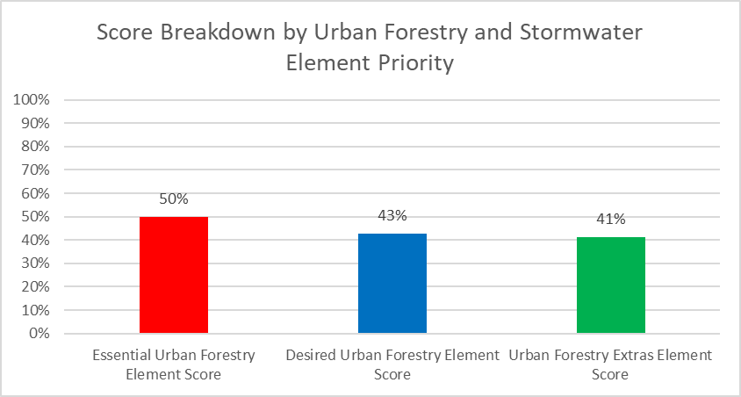
AUDIT TOOL
GREEN INFRASTRUCTURE CENTER INC.
Summary of Results
Have almost majority of the essential elements we want to see in the codes, policies and practices of the city.
The main focus with recommendations is to bring the essentials and desired elements up to a higher percentage which will result in a better managed more resilient urban forest.
50%
43%
41%

Slide 20
GREEN INFRASTRUCTURE CENTER INC.
GIC’s Top Tree Code Audit Recommendations:
Strengthen Tree Protection requirements to be more robust, such as better fencing, signage and care practices. Require these details on site plans.
Increase the Critical Root Zone past the dripline to 1.5 ft X DBH.
Establish penalties for the loss or destruction of protected trees.
Designate root soil volume and soil surface area standards.
Develop an Urban Forest Master/Management Plan.
Create a line item in the annual budget dedicated to urban forest management.
Conduct a public tree inventory.
Integrate tree inventory data with records of maintenance, inspections, mitigation, etc.
Create a policy of trees as infrastructure.
Devote a chapter/section in the UFMP to emergency management.
Establish a stormwater utility fee.
Establish a Complete Green Street policy for the city.
Set parking spaces as maximums or medians rather than minimums.
Encourage or incentivize LIDs in new and redevelopments.

Slide 21
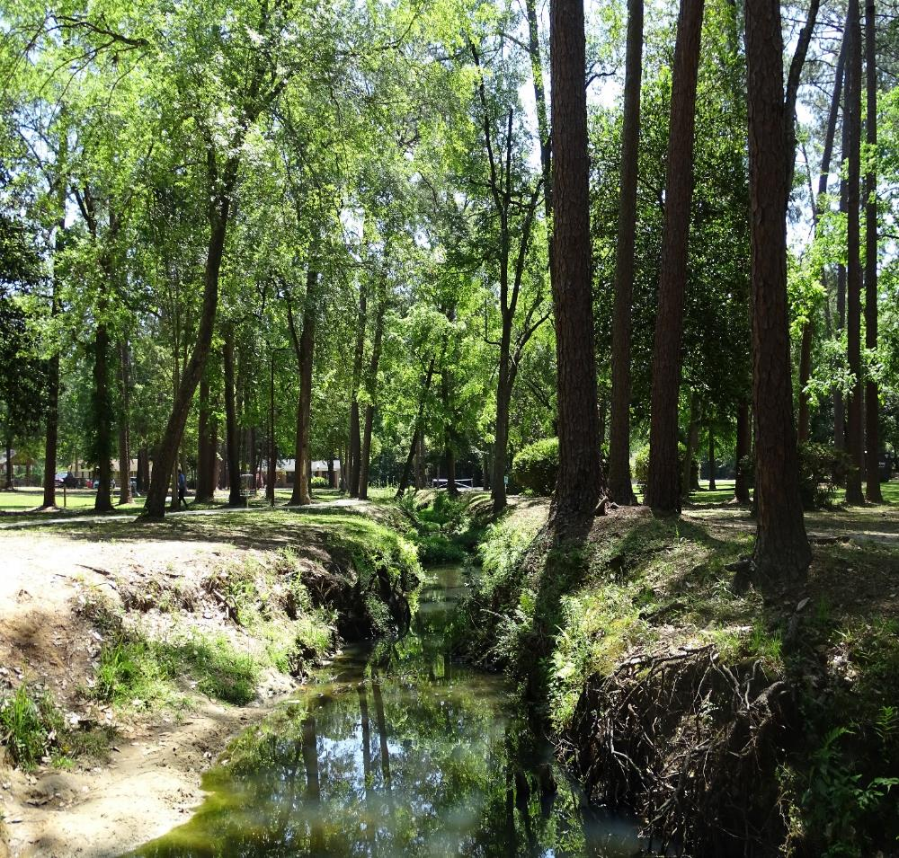
GREEN INFRASTRUCTURE CENTER INC.
Tifton Tree Canopy Goals
Maintain the current canopy of 39% over the next 10 years.
This will require planting 696 trees per year over the next 10 years for a total of 6,957 trees.
This goal still requires active tree planting and tree protection throughout the community

Slide 22
GREEN INFRASTRUCTURE CENTER INC.
Urban Forest Strategy Ideas
Identify emergency routes, assess risk and mitigate tree hazards along them.
Require more trees in the development code for parking lot designs.
Add incentives in the development code to reduce imperviousness.
Integrate more space for tree plantings in ROWs that need utilities moved.
Require tree replacement when protected trees are removed during development.
Create a tree donation fund to support tree plantings in the community.
Apply for funds to bury electrical lines and install tree wells to increase resiliency.
Plant more trees in Rights-of-way, on city-owned properties and in parks.
Prioritize low canopy neighborhoods for hosting public tree giveaways.
Plant trees and educate students at Tift County schools and universities.
Plant trees at Tifton public housing authority community properties.
Identify overly paved sites and remove impervious surfaces to allow for more space for planting trees.
Plant trees around retention ponds in places where it still provides access for maintenance.
Create partnerships and educational programming for urban forestry in the city.

Slide 23
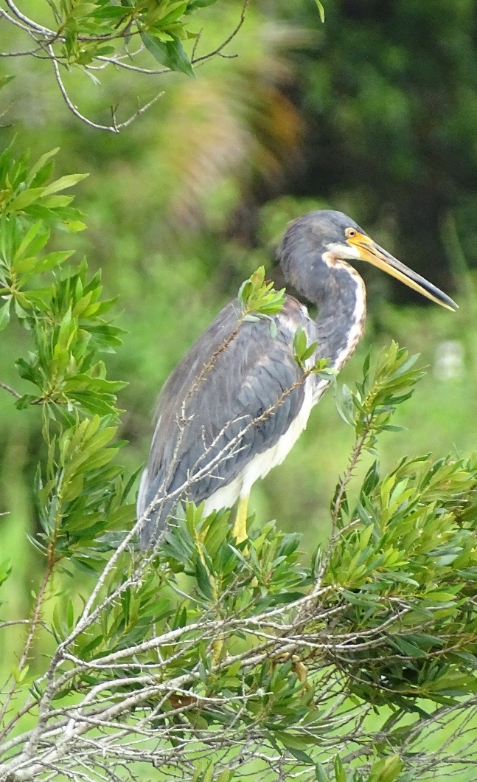
GREEN INFRASTRUCTURE CENTER INC.
Comments?
Questions?
GIC Inc.
320 Valley Street
Scottsville, VA, 22901
434-286-3119
www.gicinc.org
mlee@gicinc.org
dmatchette@gicinc.org
cschluter@gicinc.org

